Slide 1

NU - 302: Digital Image Classification
Prepared by: Mentored by:
Anirudh Sharma Dr. Prashant Srivastava
Bollam Sreekar Reddy
Potlacheruvu Sai Krishna Vamsi
Shravan Sridhar
Tavva G. N. R. S. N Prudhvith 14.03.2019

Slide 2
Overview
Rationale of the Project
Objective
Methodology
Results of the work
Difficulties Faced

Slide 3
Rationale of the Project
On the surface, teaching a computer to do something like digital image classification seemed very intriguing to us.
Moreover, there are countless real-world applications of this topic, for instance: filtering in stock photography websites, etc.
Since a lot of research on this topic has already been done, there are already quite a few solutions that we can learn from.

Slide 4
Objectives
To develop our concept of image classification from the ground-up, i.e, explore machine learning techniques first and then move onto deep learning techniques.
To research the underlying principles and techniques of image classification.
We also aim to by the end, deliver a novel technique based on already existing concepts such as traditional machine learning and deep learning techniques.

Slide 5
Methodology

Slide 6
Understanding SVM
We started with the basics
Visualization
What are the different factors that affect the end result
Implementation

Slide 7
What is SVM?
Given a labeled training data (supervised learning), the algorithm outputs an optimal hyperplane which categorizes new examples. Simply put, the following happens -

Slide 8
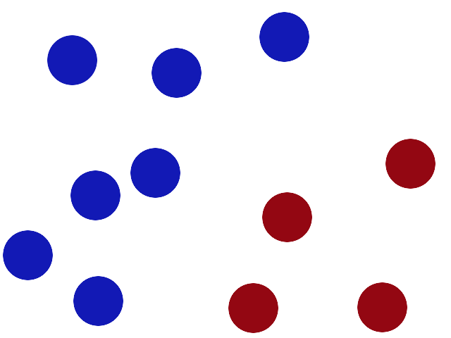

Slide 9
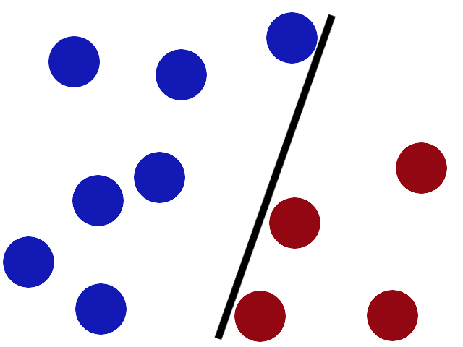

Slide 10
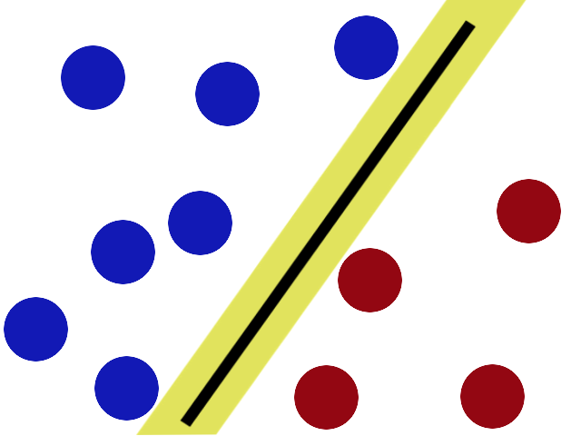

Slide 11
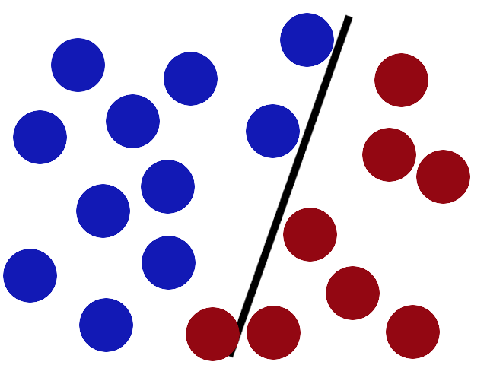

Slide 12
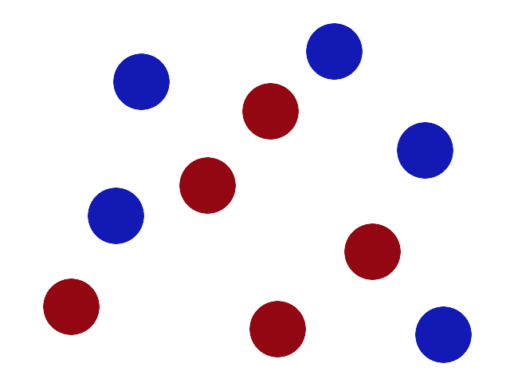

Slide 13
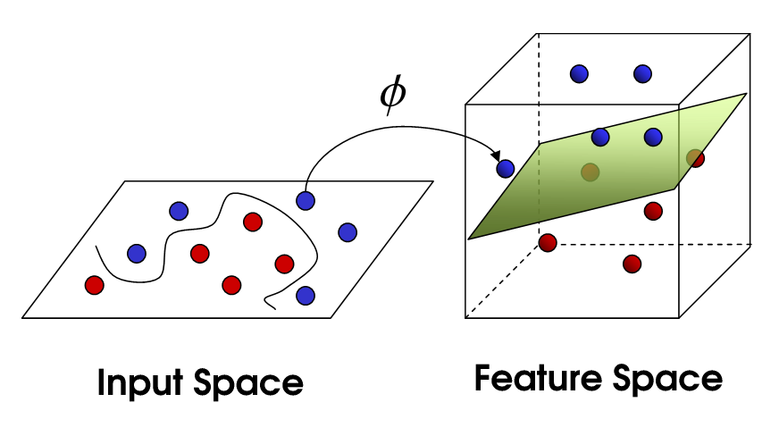
Image Source: http://i.imgur.com/WuxyO.png

Slide 14
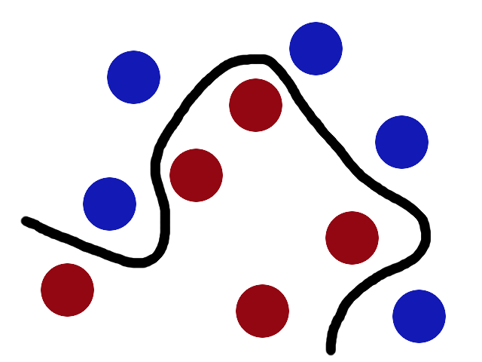

Slide 15
All the jargons we talked about
Hyperplane: The line on transformation becomes a hyperplane.
Kernels: When drawing a line to classify was no longer an option, we were forced to transform and introduce a z-axis. These transformations are called “kernels”.
Biggest Gap Trick Optimization: Finding the most optimized position of the hyperplane such that we achieve the widest possible margins.

Slide 16
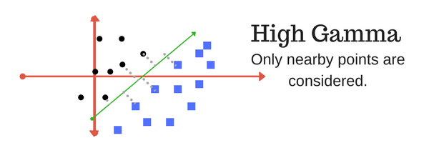
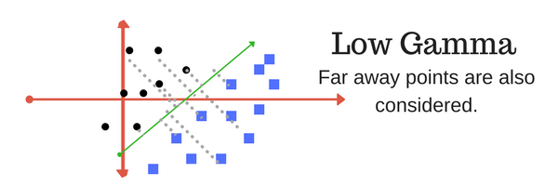
Tuning Parameters
Gamma: This parameter defines the influence of a single training example. (Gamma 𝛂 [points closer to plausible line will be considered]).
High Bias -> Low Variance
Low Bias -> High Variance
Image Source: https://bit.ly/2pFAPFo

Slide 17
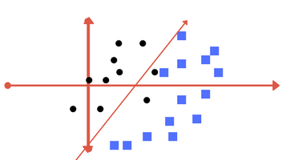
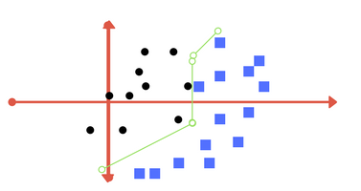
Tuning Parameters
Regularization Parameter: This parameter tells the SVM how much you want to avoid misclassifying each training example. It is represented by the variable C in all our implementations (C 𝛂 [penalty for misclassification]).
Value of C is Low
Value of C is High
Image Source: https://bit.ly/2pFAPFo

Slide 18
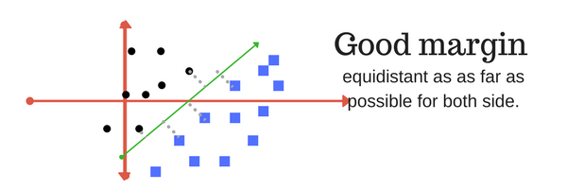
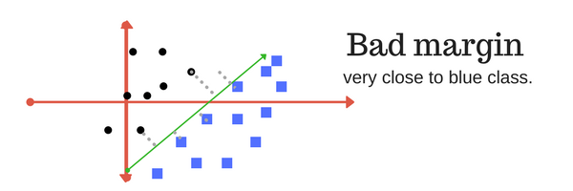
Tuning Parameters
Margin: A good margin results in a better accuracy while classifying data.
Image Source: https://bit.ly/2pFAPFo

Slide 19
Tuning Parameters
Kernel: We have used the following kernels -
Linear Kernel: Used for linear classification
Polynomial Kernel: Here similarity function is a polynomial function.
RBF Kernel: This kernel is used for nonlinear classification with Gaussian function as the similarity function
Image Source: https://bit.ly/2pFAPFo

Slide 20
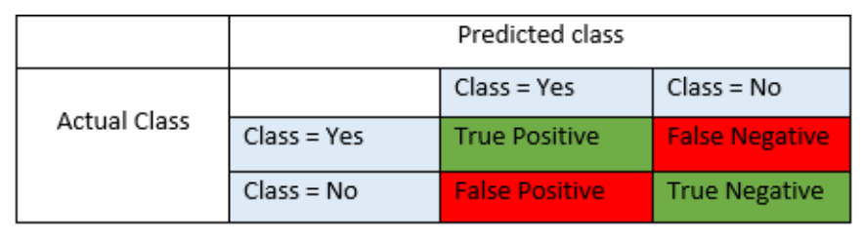
Basic Metrics
Accuracy = TP+TN/TP+FP+FN+TN
Precision = TP/TP+FP
Recall = TP/TP+FN

Slide 21
Implementation

Slide 22
Pre-Processing
Operations such as flip, crop and hue adjustments are made so as to increase the quality of datasets and also the number of trainable images.
Each image is converted into gray scale and then resized to 64*64.
This 2D matrix with gray scale values of image is flattened (stacked horizontally) which is our feature vector.

Slide 23
S.V.M classifier To Predict Iris Flower Category

Slide 24
Dataset Description
Classes | 3
Samples per class | 50
Samples Total | 150
The Attributes in the iris dataset are sepal length & width, petal length & width in (cm).
The Target classes are Iris-setosa, Iris-versicolour, Iris-Virginica.

Slide 25
Understanding Data
From the data, the possible values of the target classes are 0, 1 and 2 in which,
0-50 are Setosa
50-100 are Versicolor
100-150 are Virginica

Slide 26
Can we apply SVM for iris dataset?

Slide 27
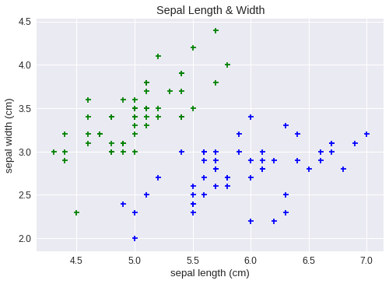
Visualizing Iris dataset
We take the first 2 features with targets 0 & 1.

Slide 28
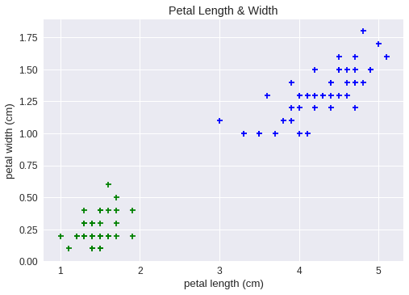
Visualizing Iris dataset
We take the last 2 features with targets 1 & 2.

Slide 29
Kernels & Parameters
When we take a lower value of C(C=1), accuracy is 93.33% for RBF kernel [Taking gamma =1 ]
precision recall f1-score support 0 1.00 1.00 1.00 12 1 0.88 0.88 0.88 8 2 0.90 0.90 0.90 10 micro avg 0.93 0.93 0.93 30 macro avg 0.92 0.92 0.92 30 weighted avg 0.93 0.93 0.93 30

Slide 30
Kernels & Parameters
When we take a higher value of C(C=100), accuracy is 86.66% for RBF kernel [Taking gamma=1]
precision recall f1-score support 0 1.00 1.00 1.00 12 1 0.70 0.88 0.78 8 2 0.88 0.70 0.78 10 micro avg 0.87 0.87 0.87 30 macro avg 0.86 0.86 0.85 30 weighted avg 0.88 0.87 0.87 30

Slide 31
Kernels & Parameters
When we take a lower value of C(C=1), accuracy is 96.66% for linear kernel
precision recall f1-score support 0 1.00 1.00 1.00 12 1 0.89 1.00 0.94 8 2 1.00 0.90 0.95 10 micro avg 0.97 0.97 0.97 30 macro avg 0.96 0.97 0.96 30 weighted avg 0.97 0.97 0.97 30

Slide 32
Kernels & Parameters
When we increase the value of C(C=100), accuracy is 96.66% for linear kernel
precision recall f1-score support 0 1.00 1.00 1.00 12 1 0.89 1.00 0.94 8 2 1.00 0.90 0.95 10 micro avg 0.97 0.97 0.97 30 macro avg 0.96 0.97 0.96 30 weighted avg 0.97 0.97 0.97 30

Slide 33
Modelling different kernel classifiers using Sepal features

Slide 34
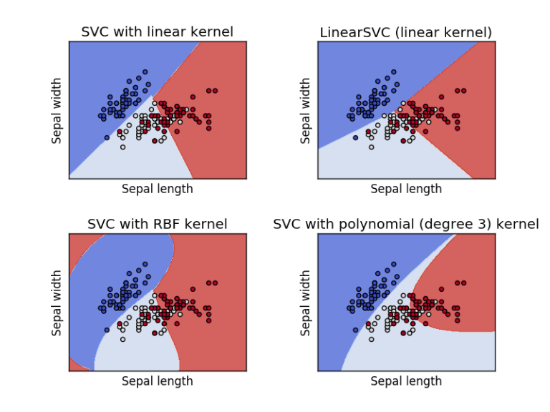

Slide 35
Modelling different kernel classifiers using Petal features

Slide 36
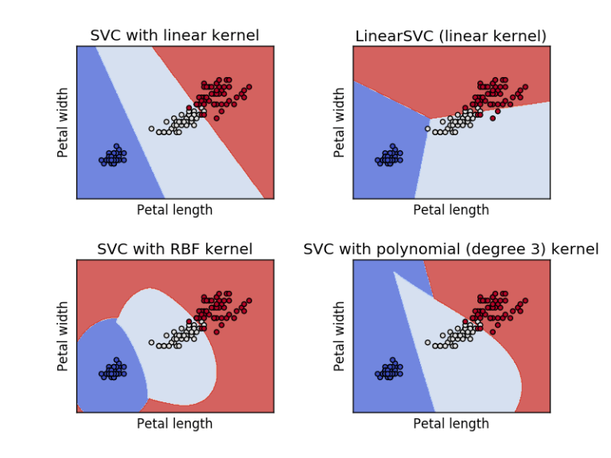

Slide 37
S.V.M. using Image pixel values as features

Slide 38
Dataset
The dataset contains RGB images of 5 different classes. Each image is stored in format ‘[class_name][serial_no].jpg’
67 images containing dalmatian dog at different ages, animated non animated, with and without background.
53 dollar bill images are cropped to fit the bill.
53 images of pizza slices cropped from advertising posters, with and without background.
65 soccer ball images.
85 sunflower images taken in natural setting, some pictures are included with the entire plant.
Dataset contains a total of 323 pictures. And classes are labelled as [0-4].

Slide 39
Why S.V.M. over Clustering?
Dimensionality reduction using principal component analysis was performed on our feature vector, so that it can be visualized graphically. This helped us to understand there are too many overlaps among the classes and hence cannot be clustered.

Slide 40
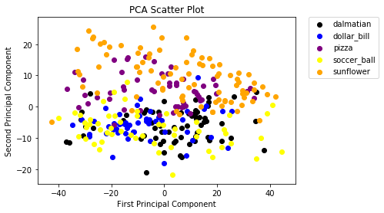

Slide 41
Kernel used and parameter values
We used two kernels. One was linear kernel as the data was not linearly separable and the accuracy in that case was very low, so we had to shift to RBF kernel which resulted in a comparatively better F1 score.
After conducting experiments on C values {1,10,100,1000} and gamma values {0.001,0.0001}, we found out that C = 1 and gamma = 0.001 yielded the best results.

Slide 42
Results and Metrics
Classes | Precision | Recall | F1 Score
Dalmatian | 0.78 | 0.82 | 0.80
Dollar bill | 0.88 | 0.93 | 0.90
Pizza | 1.00 | 0.88 | 0.93
Soccer Ball | 0.88 | 0.70 | 0.78
Sunflower | 0.83 | 1.00 | 0.91
Micro average | 0.86 | 0.86 | 0.86

Slide 43
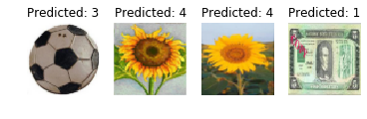

Slide 44
Difficulties Faced
A lack of a more varied and plentiful data set resulted in a loss of accuracy.
Our low-spec laptops resulted in very high training/testing times.
Some concepts were very challenging to understand/visualize.
Notes:
CNN is a self learning feature

Slide 45
References
https://en.wikipedia.org/wiki/Linear_discriminant_analysis
https://www.analyticsvidhya.com/blog/2017/09/understaing-support-vector-machine-example-code/
https://medium.com/machine-learning-101/chapter-2-svm-support-vector-machine-theory-f0812effc72

Slide 46
Thank You

